Slide 1


Generative AI and LLMs: A Comprehensive Introduction
Welcome to the world of Generative AI and Large Language Models. This presentation will guide you through the fundamentals. Explore the architecture, capabilities, and applications of these technologies. Understand their impact across various industries and domains.
by Rinesh Sulendran

Slide 2
AI, ML, and Deep Learning: Core Concepts
Artificial Intelligence (AI)
Machine Learning (ML)
Deep Learning
AI is the broad concept of machines mimicking human intelligence. It includes problem-solving and decision-making.
ML is a subset of AI. It
Deep Learning is a subset of ML using neural networks. These networks have many layers. They analyze data with intricate patterns.
enables systems to learn from data. They improve without explicit programming.

Slide 3

Generative AI: Unveiling the Magic
1
What is Generative AI?
2
Evolution
Early models include GANs. Modern models include transformers.
Generative AI models create new content. This includes text, images, and audio.
3
Applications
Generative AI is used for art, music, writing, and design. The possibilities are limitless.

Slide 4




Large Language Models (LLMs): The Power of Text
Understanding LLMs
Impact on Industries
Applications Across Domains
LLMs are trained on vast amounts of text data. They generate human-like text.
LLMs revolutionize content creation. They impact customer service and data analysis.
LLMs can summarize documents. They translate languages. They answer questions effectively.

Slide 5




GPT-4: The Cutting Edge
Architecture
GPT-4 is based on the transformer architecture.
Capabilities
It generates high-quality, coherent text.
Use Cases
It is used for writing, coding, and analysis.

Slide 6

Llama 3.2: An Open-Source Alternative
1
Features
Llama 3.2 is designed to be efficient and accessible.
2
Differences from GPT-4
It offers a balance of performance and open access.
3
Community Support
It benefits from open-source contributions.

Slide 7



Generative AI in Software Testing: Potential
1
Code Generation
2
Test Case Generation
3
Bug Detection
Generative AI can revolutionize software testing. It automates test case creation. It assists in debugging. It can also find edge cases.

Slide 8
Generative AI in Software Testing: Limitations
1
Bias
2
Accuracy
3
Explainability
Generative AI may produce biased results. Its accuracy depends on training data. Explainability remains a challenge.

Slide 9
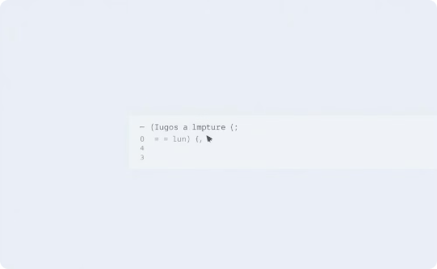
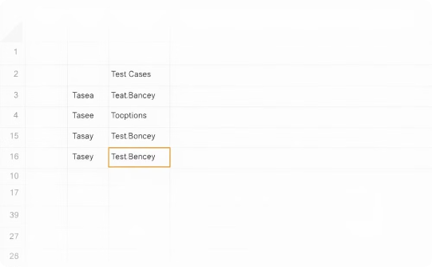

Applications of Generative AI in Software Testing
Automated Bug Detection
Test Case Generation
AI Assistant
AI can identify bugs in code.
AI can create test cases automatically.
AI can work as a software testing assistant.

Slide 10

Key Takeaways and Next Steps
Generative AI is transformative.
LLMs are powerful.
Testing has many limitations.
They are essential tools for language tasks.
It changes how we create content.
It is important to proceed with caution.

